Slide 1
A PRESENTATION ON BIM BY
LALTA PRASAD
CIVIL DEPARTMENT

Slide 2
INTRODUCTION
BIM as the process of generating and managing building data during its life cycle using three-dimensional, real-time, dynamic building modeling software to decrease wasted time and resources in building design and construction.
BIM is an intelligent model-based process that provides insight to help you plan, design, construct, and manage buildings and infrastructure.

Slide 3
DEFINITION
The American institute of Architect (AIA) define BIM As a model based technology linked with a database of project information.
Building information modeling is a parametic,3D model that use to generate plans, sections,elevetions schedules of all necessary components to document the design of a building.

Slide 4
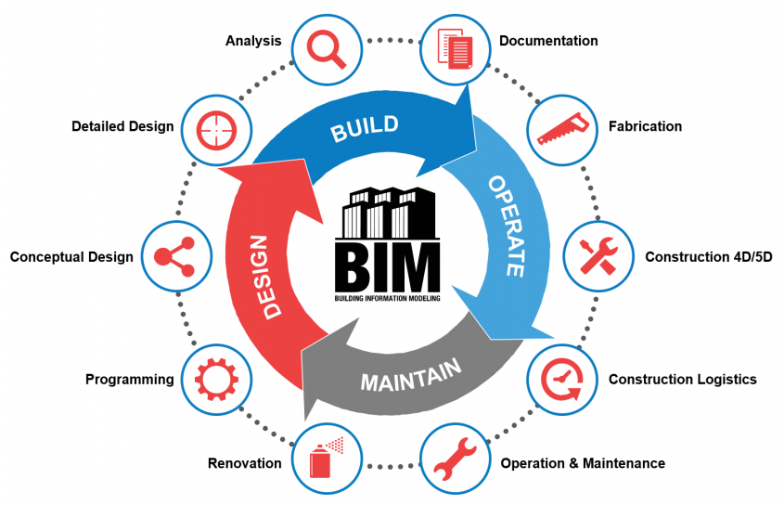

Slide 5
History of BIM
First conceptual idea by Douglas C. Englebert in 1962.
In 1963, the first computer-aided design (CAD) with a graphical user interface, “Sketchpad”, was developed at the MIT Lincoln Labs by Ivan Sutherland.
In 1975, Charles Eastman published a paper describing a prototype called Building Description System (BDS).

Slide 6
History of BIM
Robert Aish first documented the use of the term “Building Modelling” in a published paper in 1986.
ArchiCAD developed in1982 in first time BIM software in personal computer.
The duo wanted to develop an architectural version of Pro/ENGINEER that could handle more complex projects than ArchiCAD. By 2000, they had a program called Revit.

Slide 7
Evolution of BIM

Slide 11
ADVANTAGE OF BIM
Improved visualization
Faster and more efficient processes
Better service to the client
Improved productivity and quality
Increased speed of delivery
Reduced costs
Increased coordination of construction documents

Slide 12
ADVANTAGE OF BIM
Elimination in budget change up to 40%.
Precision in costs estimation up to 3%.
Decrease up to 80% of the time needed to. generate a expenditure quote.
Saving of up to 10% in the value of the contract trough clash detections.
Time saving up to 7%.

Slide 13
BIM SOFTWARE
Revit by Autodesk
ArchiCad by Graphisoft
Microstation by Bentley System
Tekla by Trimble

