Slide 1
Introduction

Slide 2



Slide 3



Slide 4



Slide 5



Slide 6
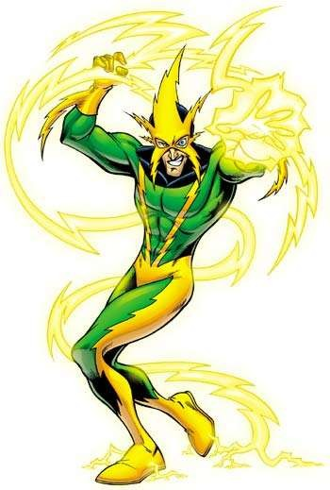


Slide 7
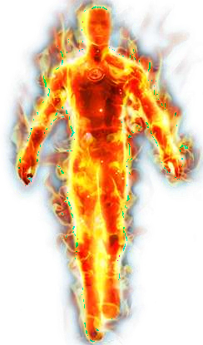


Slide 8
Graphene
"The wonder material"

Slide 9
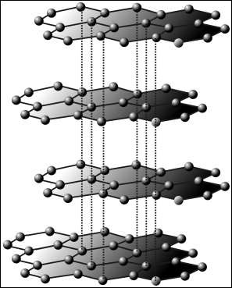
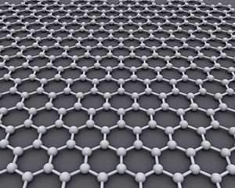
Insight
Graphene is a substance composed of pure carbon, with atoms arranged in a regular hexagonal pattern similar to graphite, but in a one atom thick sheet.
Or
Flat monolayer of carbon atoms tightly packed into a two dimensional honeycomb lattice
or
Isolated Single Layer of Graphite

Slide 10
History
The theory of graphene was first explored by P. R. Wallace in 1947 as a starting point for understanding the electronic properties of 3D graphite.
The earliest TEM images of few-layer graphite were published by G.Ruess and F. Vogt in 1948.
Later, single graphene layers were also observed directly by electron microscopy.
Before 2004 intercalated graphite compounds were studied under a transmission electron microscope (TEM).

Slide 11
Mechanical Properties
Strongest Material till date
Young's Modulus- 1 TPa ( Steel 0.2 Tpa)
4 x stronger than diamond
No crystal boundaries
Pure Single layer sheet
Specific Weight
Flexible
- 0.77 mg / sq.m
- 340 - 600 N/m

Slide 12


Slide 13
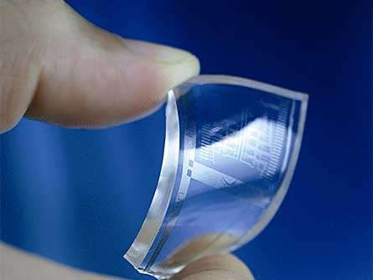
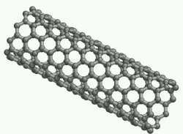
Thermal & Optical Properties
Thermal Conductivity
  (Diamond 1200W/m.k)
Transparent in nature
98% visual transmission rate, absorbs 2.3% white light
- 5000 W/m.K
Thinnest 0.335 nm

Slide 14
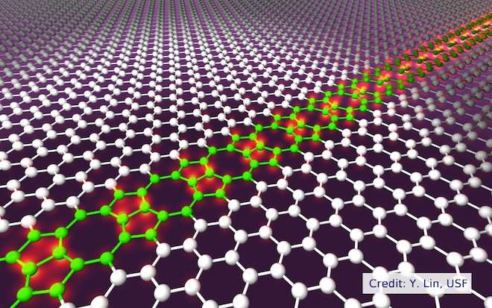
Electrical Properties
High electrical conductivity
Zero Gap conductivity
Resistivity
5000 W/mK.
10⁻⁶ Ωcm
Charge carriers behave massless
Little Scattering
High mobility

Slide 15
Applications

Slide 16
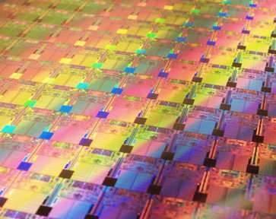
Integrated Circuits
High mobility of charge can be integral in IC
Fast processing
Replaces Silicon

Slide 17
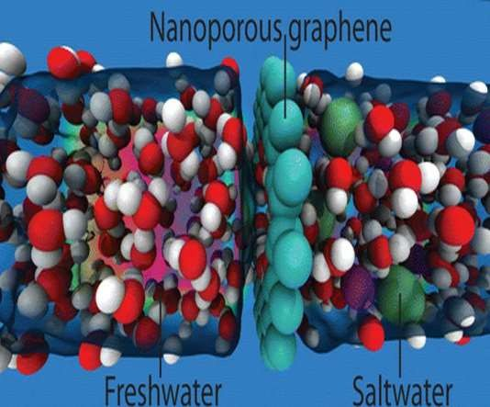
Distillation
It allows only water to pass through it.
Making ideal for purification process. Eradication of Water scarcity
Desalination

Slide 18
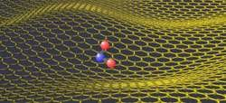
Gas Sensors
Can detect effect of a single molecule associating with
graphene
Effects the electric properties with addition of any foreign atom

Slide 19
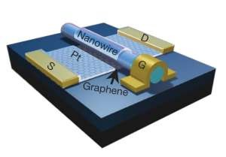
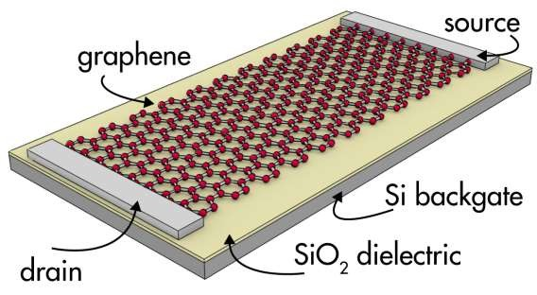
Transistors
More Efficient than silicon transistors
Can be easily controlled by electric field
Can run at higher frequency
Increase speed of Circuits

Slide 20
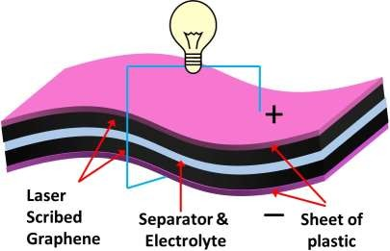
Ultra-Capacitor
High surface to mass ratio
Two sheet of graphene with electrolyte in between
May replace batteries
High recharge rate and slow discharge
Long life

Slide 21
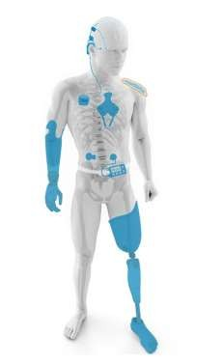
Bionic Devices
Non corrosive
Biodegradable
High conductivity
Non toxic compared to conventional electrode used in bionic device

Slide 22
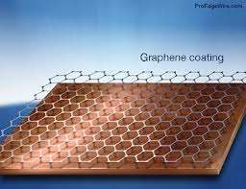
Protective Coating
It is resistant to acids, alkalis etc.
Being impermeable
Coating of containers, Jars etc
Paints for car body, steel structure

Slide 23
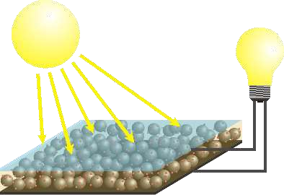
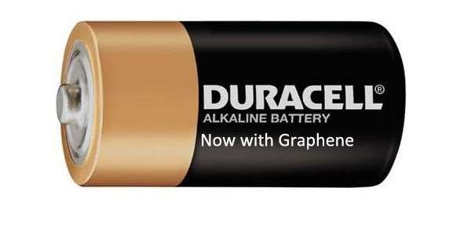
Solar Cell
It is super capacitor
With high recharge rate and a normal discharge rate

Slide 24
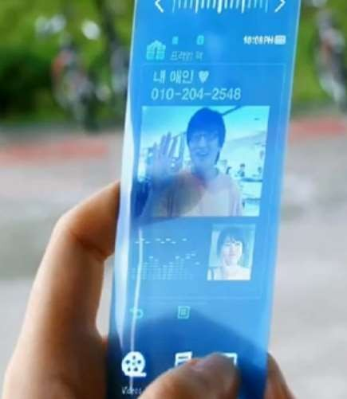
Flexible Mobilephone
It can be used to make flexible LED screen that can be used in
mobile phones.

Slide 25
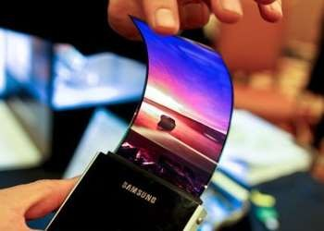


Conclusion
You lost ur phone again!!
No worries buy a new!

Slide 26
THANK YOU

