Slide 1
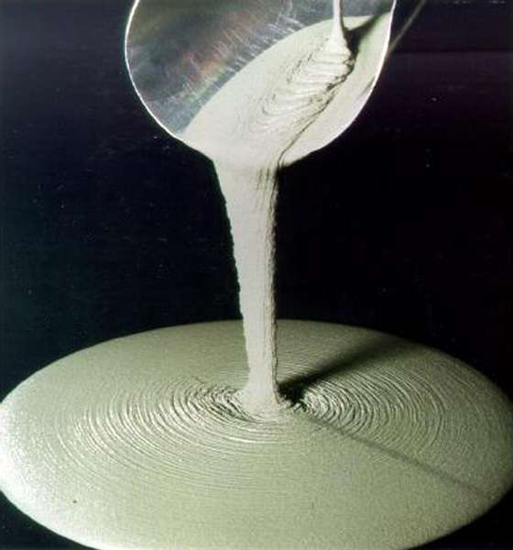
Reactive powder concrete
Presented by:
Toaha Mohammad
Asst. Professor
Vision Institute of Technology
Aligarh

Slide 2
Outline
Introduction
Raw Material Components
Typical R.P.C Mix
Properties
Comparing Properties
Comparison Among Concretes
Applications of R.P.C
References

Slide 3
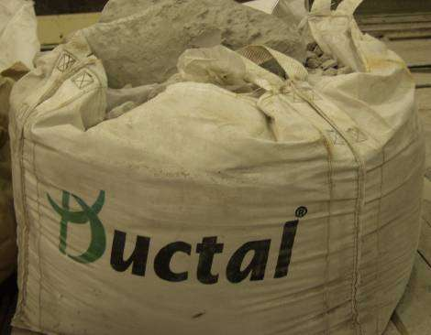
Introduction
Advanced cementitious composite material
Batter mechanical and durability properties
Bouygues Laboratory in France
Light in weight
High in strength
Notes:
The most popular engineering material is a concrete. It is used for buildings,
industrial structures, bridges and dams. Every day the concrete is improving, to
achieve better characteristics, lesser price and to be environmental acceptable. In
introduction the historical overview of concrete is given – from the ancient
civilizations to 21
st
century.

Slide 4


12 millions years old
3000 years BC , Egyptians - mud mixed with straw to bind dried bricks.
Gypsum mortars and mortars of lime in the pyramids

Slide 5
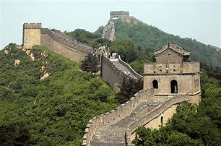

Chinese used cementitious materials to hold bamboo together in the Great wall

Slide 6


Appian Way, Roman baths, the Coliseum and Pantheon in Rome
Notes:
Romans used pozzolana cement from Pozzuoli, Italy
near Mt. Vesuvius to build the Apian Way, Roman baths, the Coliseum and
Pantheon in Rome

Slide 7

Coliseum, Rome

Slide 8

Pantheon

Slide 9

1828 I. K. Brunel
British civil enginee
first significant engineering application of portland cement
Thames Tunnel

Slide 10
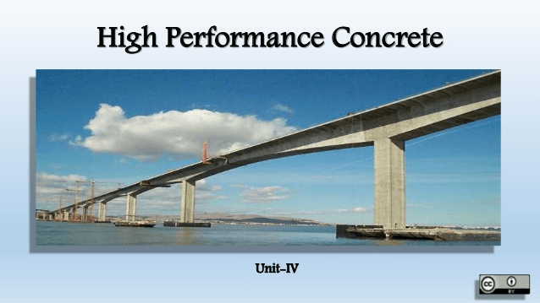
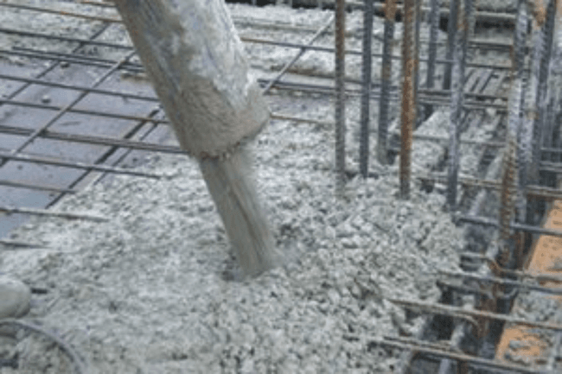
Middle of 20 century - High Performance Concrete (HPC)

Slide 11
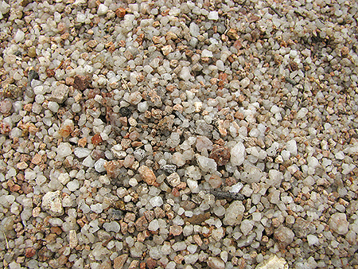
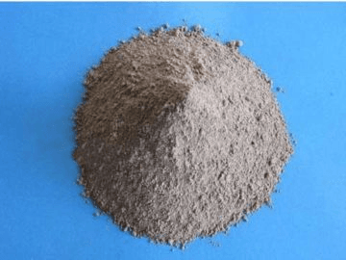
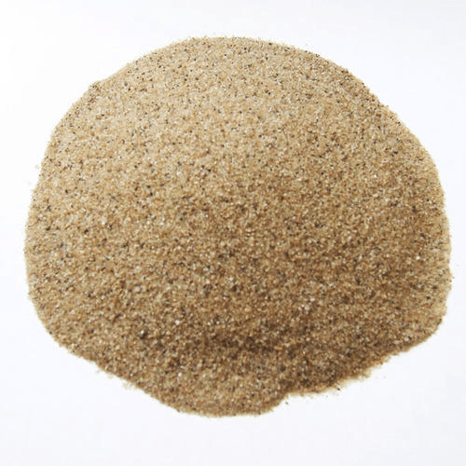
Components for RPC mixture
Cement
high C2S &
C3S
Fine Aggregate
  Quartz Sand
  Crushed Quartz
  Two fractions of this material are used one with soil size of 0.125 – 0.25 mm, other with 0.25 – 0.5 mm

Slide 12
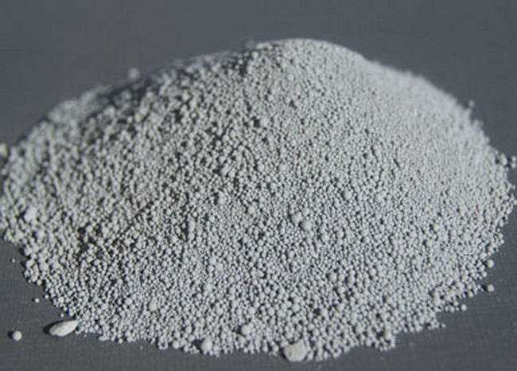
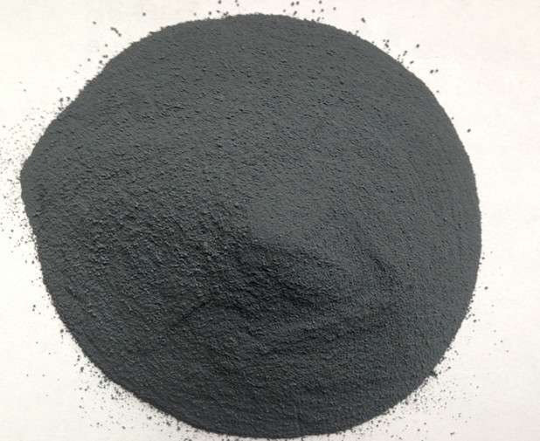
Raw Material
Components
Cement
high C2S & C3S
Quartz Sand
Crushed Quartz
Silica pozzolan
highly reactive
sufficiently fine
Reactive Powders
Silica fume, Simcoa,
Micro silica 600, &A.F.M
Notes:
Dicalcium Silicate (C2S) hardens slowly
2 C3S + 6H → C3S2H3 +3 Ca(OH)
2 C2S + 4H → C3S2H3 + Ca(OH)2

Slide 13



Continue…
Micro-Fibers - metallic
or poly-vinyl acetate
length-12mm
dia-0.2mm
2000MPa
Nano Fillers
Super plasticizer
Water

Slide 14
What is the typical R.P.C mix ?
What is the typical R.P.C mix ?
Cement
Cement
  710 kg/m³⁽⁾
  28 - 30%
Silica fume
Silica fume
  230 kg/m³
  9 – 10%
Crushed Quartz
Crushed Quartz
  210 kg/m³
  8.5 – 9%
Quartz Sand
Quartz Sand
  1020 kg/m³
  42 –43%
Fibres
Fibres
Super plasticizer
Superplasticizer
  40 - 160 kg/m³
  1.7 – 6.5%
  13 kg/m³
Total water
  0.6%
Total water
  5.5 – 6%
  140 kg/m³
w/b 0.20
No aggregates !
No aggregates !

Slide 15
Properties
Properties:
  High strength — 200 MPa
  Self compacted
  Very low porosity
Properties are achieved by:
  Max. particle size ≤ 300 μm
  Optimized particle packing
  Low water content
  Steel fibers
  Heat-treatment

Slide 16
Comparing Properties
Reactive powder concrete
Ordinary concrete
Compressive strengths up to 200 Mpa
Flexural Strengths up to 50 Mpa
Modulus of Elasticity 45 to 50 GPa
Ductile
strong
Durable
High bending tensile strength
Low capillary porosity (high endurance)
High resistance to deicing salt
Greatly reduced permeability to moisture, chlorides and chemical attack
Increased resistance to abrasion, erosion and corrosion
Speedy construction
Compressive Strength 25 to 35 Mpa
Relatively Weak
Extremely Brittle
Almost no tensile strength
High thermal expansion and contraction with temperature fluctuations

Slide 17
Comparison Among Concretes
Ordinary Performance
Concrete
High Performance Concrete
Reactive Powder Concrete
Strength : 20–40 MPa
Porosity : 10–20%
Strength : 50–100 MPa
Porosity : 5–8%
Strength : 150–300 MPa
Porosity : 2% below

Slide 18
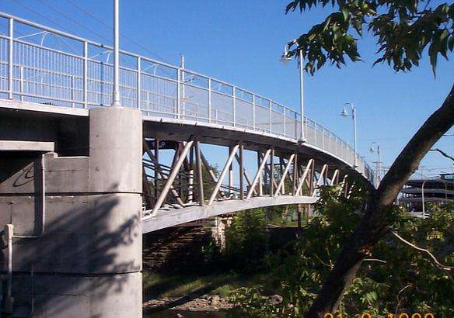
Applications of R.P.C
Scraper paths in treatment plants
Architecture
Bridges
Narrow supports
Filigree beams
Thin or slab-like components
Buttresses for high pressures
R.P.C Pedestrian Cable-Stayed Bridge
Sherbrook Bridge in Canada

Slide 19
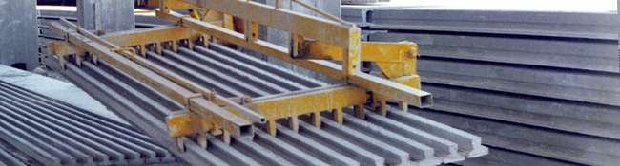
Filigree beams

Slide 20
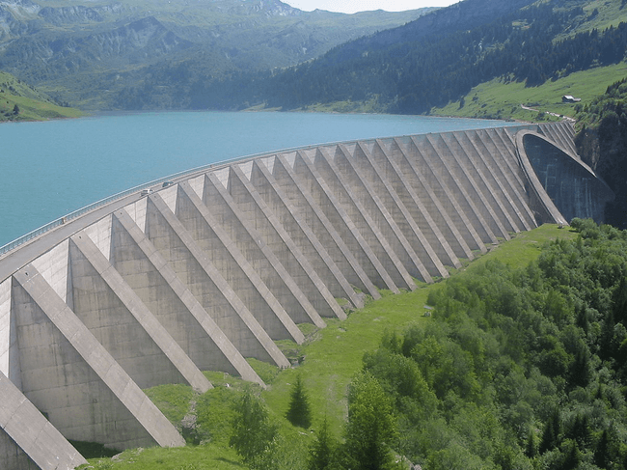
Buttresses For High Pressures

Slide 21
References
Lee N.P. &Chisholm D.H. (2005) R.PC. Study Report SR 146, BRANZ Ltd, Judge ford, New Zealand
UHPC Pathway to commercialization. Homeland security, Science and technology.
http://www.dhs.gov/xlibrary/assets/ultra-high-performance-concreteroadmap.pdf. Accessed August 21, 2012.
http://www.tfhrc.gov/focus/nov04/01.htm
http://www.cement.org/tech/cct_con_design_uhpc.asp

