Slide 1
PRESENTATION ON VR & AR
BY ANKIT UPADHYAY CIVIL DEPARTMENT

Slide 2
COVER TOPICS
Definition of Vertual Reality
Definition of Agumented Reality
AR in Civil Engineering and Construction
Benefits of AR in Civil Engineering

Slide 3
DEFINITION OF VERTUAL REALITY
Vertual reality is the use of computer technology to create a simulated environment.
Unlike traditional user interfaces, VR place the user inside an experience.
Instead of viewing a screen in front of them, user are immersed and able to interact with 3d worlds.

Slide 4
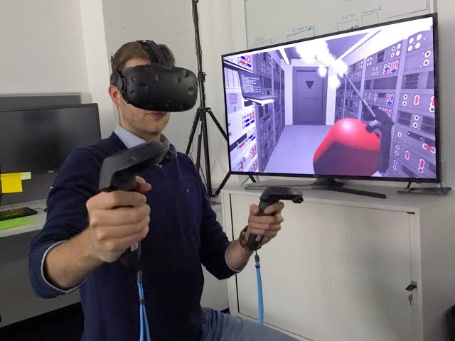

Slide 5
Definition of Augmented Reality
Augmented reality (AR) is an interactive experience of a real-world environment where the objects that reside in the real world are enhanced by computer-generated perceptual information.
AR can be defined as a system that fulfills three basic features: a combination of real and virtual worlds, real-time interaction, and accurate 3D registration of virtual and real objects.

Slide 6
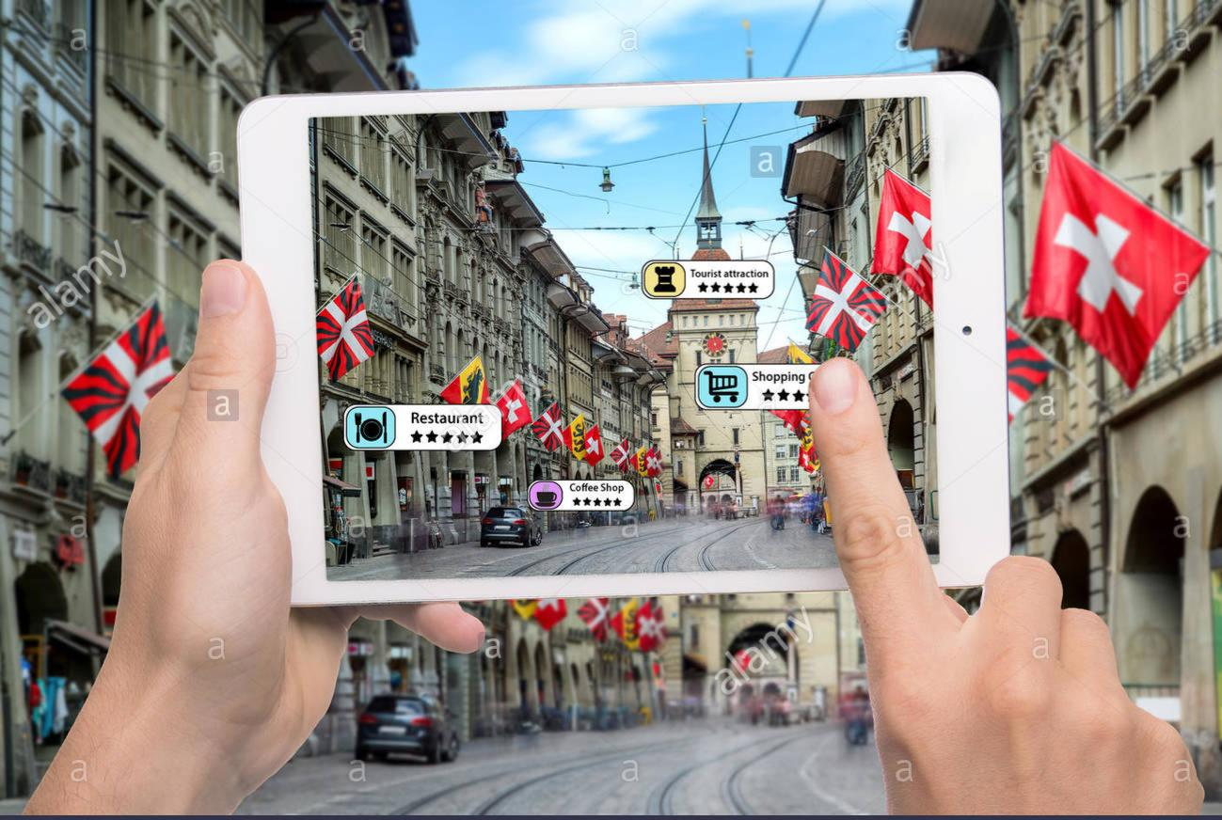

Slide 7
AR in Civil Engineering and Construction
Augmented Reality offers tremendous benefits to civil engineers and the construction industry. Right from comparing the 'as-planned' with the 'as-built' status of the projects to enhancing collaboration opportunities, recent applications of Augmented Reality in engineering have helped in improving the performance in different areas of the construction and engineering domains.

Slide 8
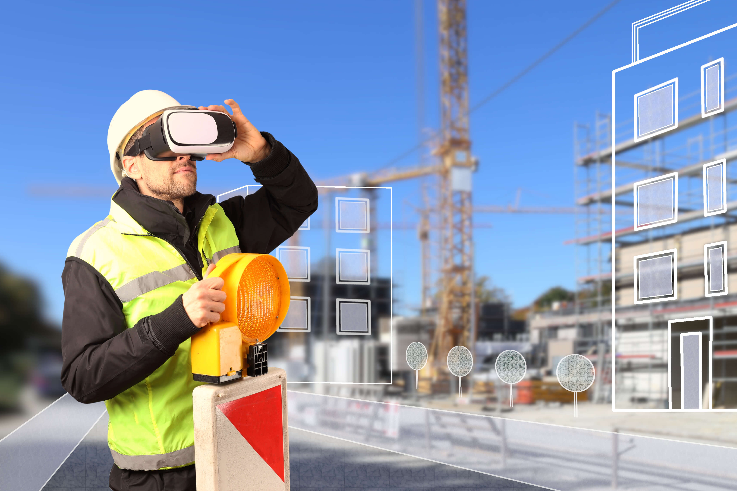

Slide 9
Benefits of AR in Civil Engineering
Some of the major benefits of using AR in engineering environment are-
Efficient Translation of Architectural Drawings
Error Reduction during Construction
Better Marketing of the Construction Projects
Saving Valuable Man-Hours
Easy Review of Project Designs
Overall Cost Reduction

Slide 10
Efficient Translation of Architectural Drawings
It involves multiple steps, which include identification of various structural elements followed by a flawless construction.
As a project is generally envisaged in stages, errors might slowly creep in during construction.
However, as AR provides a virtual image of the construction structure, such errors can be easily eliminated.

Slide 11
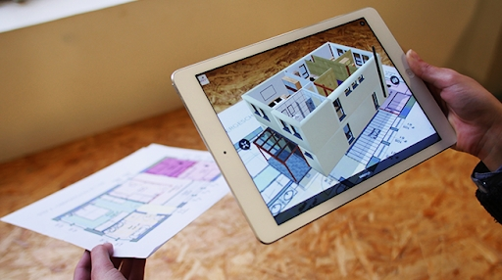

Slide 12
Error Reduction during Construction
One of the most important benefits offered by this technology to civil engineers is the minimization of errors that occur while implementing the completed design during construction.
AR provides a virtual design of the entire construction field, making it easier to control various processes, thereby helping the engineers achieve a better output.

Slide 13
Better Marketing of the Construction Projects
Explaining construction projects to people without a technical background is a problem faced by majority of the civil engineers and architects.
However, by making use of the AR concept, clients can be presented with a virtual tour using different colors and providing different views of the project.
This serves as a superior marketing strategy, which can be implemented by realtors and other businesses in the construction industry.

Slide 14
Saving Valuable Man-Hours
Using AR will reduce the errors that tend to occur while executing an approved civil engineering plan.
The errors can be caused by numerous factors such as misreading of drawings, calculation errors, etc. Such errors can be easily avoided by using AR

Slide 15
Easy Review of Project Designs
Building plans under consideration can be easily reviewed by project managers and other authorities on a real scale using AR.

Slide 16
Overall Cost Reduction
As error rectification prevents the possible errors during construction, the costs associated with the manpower and the materials used are also minimized, thereby reducing the overall cost of a construction project.

