Slide 1
Presented By-
Agriculture Engineering Department
Vision Institute of Technology, Aligarh

Slide 2
Overview
Definition of Smart farming.
Advantages of Smart Agriculture.
Disadvantages of SmartAgriculture.
Wireless Multipurpose Agricultural Robot.
Operation
Advantages

Slide 3
Definition of Smart farming
Smart Farming is a farming management concept using modern technology to increase the quantity and quality of agricultural products.

Slide 4
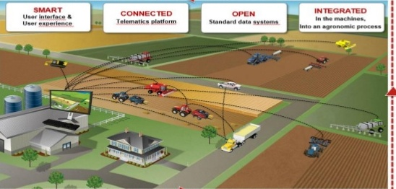
Why IOT ?
Today , India ranks second in the world in farm output 64% of cultivated land dependent on monsoons.
Irrigation account for 55-75% of water usage in India.
Nearly 60% of the water used In irrigation is wasted.
We conserve water by using soil moisture sensors.

Slide 5
Advantages of Smart Agriculture
◆ It allows farmers to maximize yields using minimum resources such as water, fertilizers, seeds etc.
◆ Solar powered and mobile operated pumps save cost of electricity.

Slide 6
Disadvantages of Smart Agriculture
◆ The smart agriculture needs availability of internet continuously. Rural part of most of the developing countries do not fulfil this requirement. Moreover internet connection is slower.
◆ The smart farming based equipments require farmers to understand and learn the use of technology. This is major challange in adopting smart agriculture farming at large scale across the countries.

Slide 7
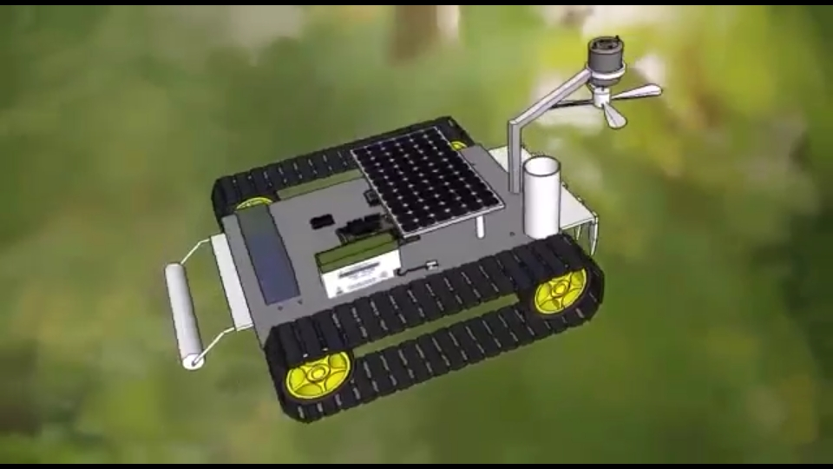
Wireless Multipurpose Agricultural Robot
The main motive for developing Agricultural Automation Technology is decreasing labour force, a phenomenon common in the developed world. The reasons are the need for improved food quality.
Agricultural Robot for Spraying water, seeding, Mulching and cutting operation”. More than 42% of the total population in the world has chosen agriculture as their primary occupation.
These robots are used for agricultural operations perform autonomously such as ploughing, seed sowing, mud closing and water spraying.

Slide 8
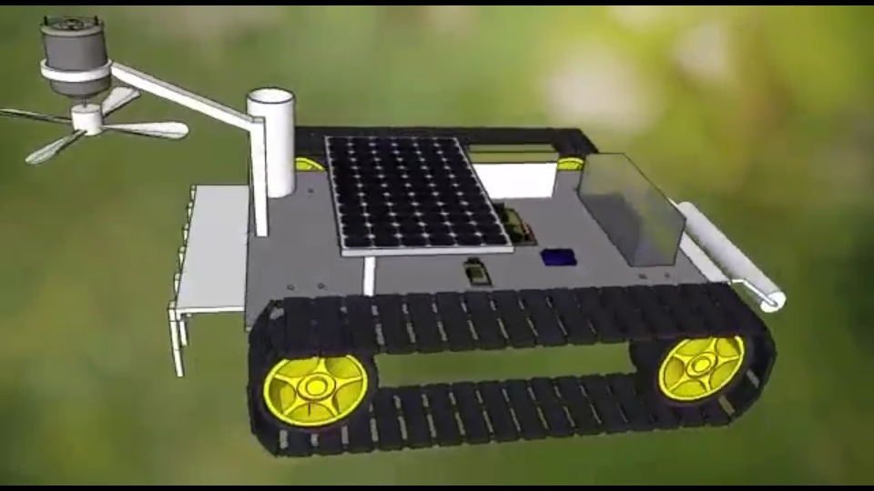
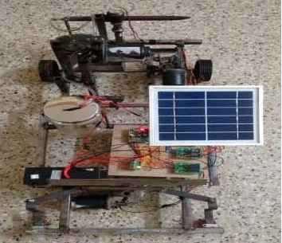

Slide 9
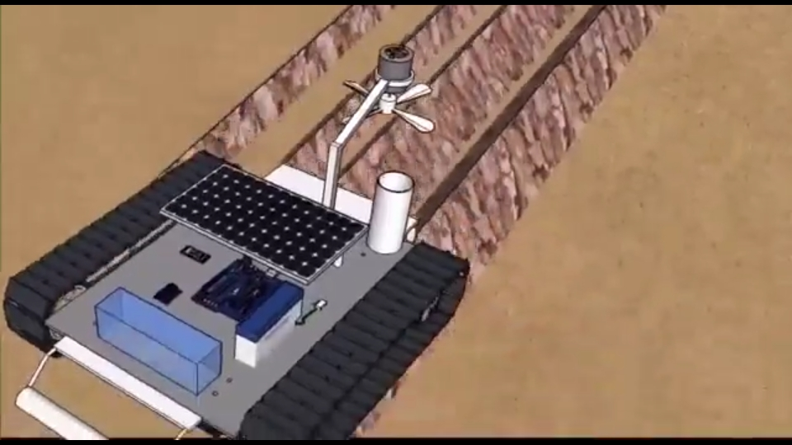
Tillage function
The primary purpose of tillage is to turn over the upper layer of the soil, bringing fresh nutrients to the surface, while burying weeds and the remains of previous crops and allowing them to break down.

Slide 10
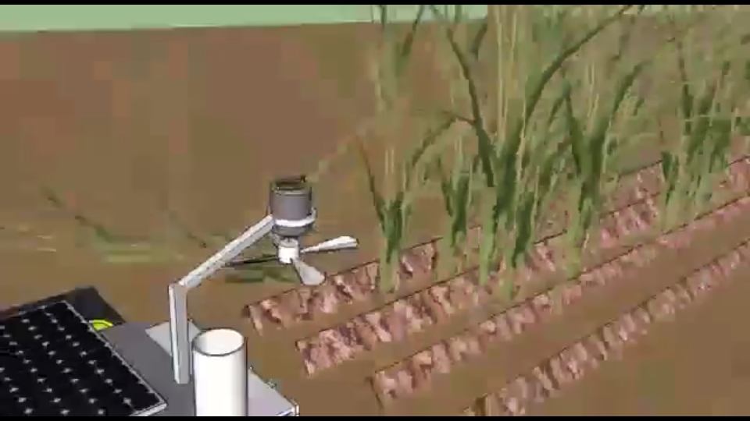
Cutting
Cutting operation is performed by cutter provided at front side of the model. The height of cutter can be maintained according to the requirement.

Slide 11
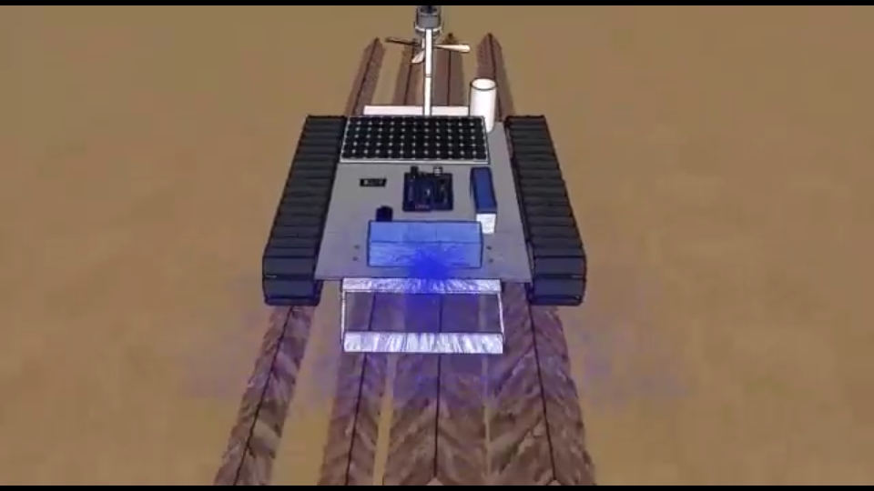
Irrigation function:
Irrigation is the method in which a controlled amount of water is supplied to plants at regular intervals for agriculture. Drivers are used for water pump to spray the water in the field.

Slide 12
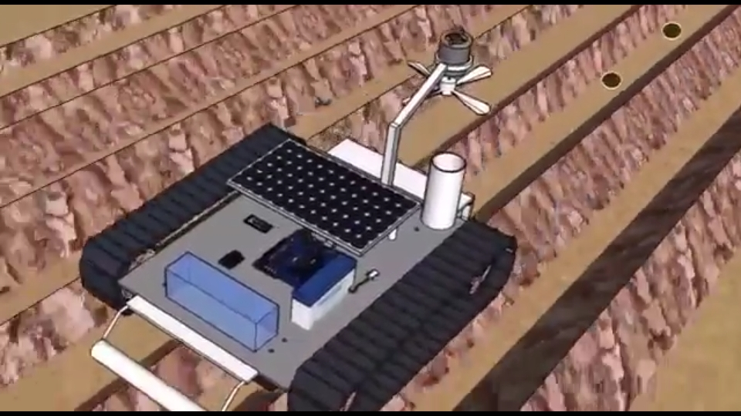
Seed sowing
It is function Seeding is planting seeds in a place or on an object. The movement of wheels of the robot causes the shaft to throw the seeds to the field.

Slide 13
Advantages
Reduce the workload on the farmer and as it is easier to operate.
The former need not spry in the hot sun, he can operate the device while standing in a cooler place.
By the development of these robots lot of manual labour will also be decreased and the farmer life will save from chemicals

Slide 14
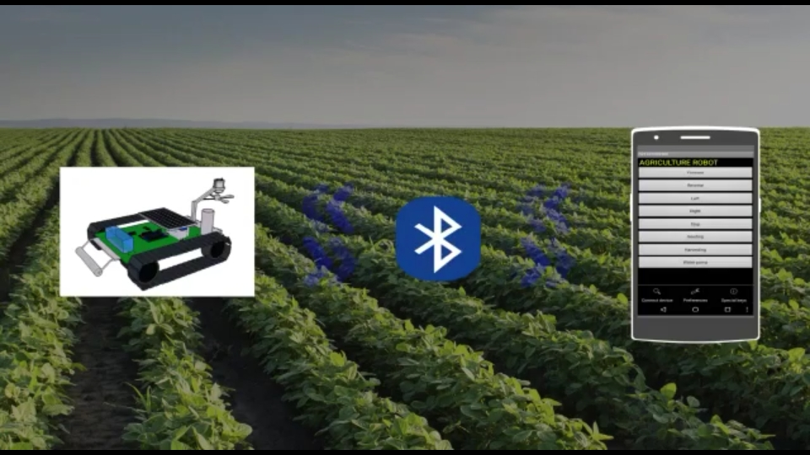

Slide 15
Thank You

